Slide 1
IST687 – Applied Data Science
Introduction

Slide 2
My Background
Computer Science/Information Science/ Business Degrees
Started life as a Programmer
Led Visualizations & High Performance Computing Teams
Created a “Common Customer View” (across retail products)
Invested in tech companies - Venture Capital
Ran Credit Card Risk Platform - Credit & Fraud
Funded Research Projects

Slide 3
687 - The Basics
Big Class and
Small Class
Book – new this semester

Slide 4
Grades
Labs (10%) are designed for you to practice data processing, analysis, and management tasks. These assignments are to be completed in your lab section.
HW (22%) are also designed for you to practice the necessary skills in carrying out data processing, analysis, and management tasks.
Class Participation (13%) includes attendance and participation in-class.
Mid-term quiz (25%) is designed to evaluate your mastery of concepts, methods, and tools in data analysis and management.
Final project (25%): For the final project you work on a dataset provided to you, transform the data as needed, and provide a written analysis with visualizations.
Students will be assigned into a group (4-7 students) - the grade is comprised of:
5% for the project updates (1% for each of the 5 project updates submitted)
20% final submission

Slide 5
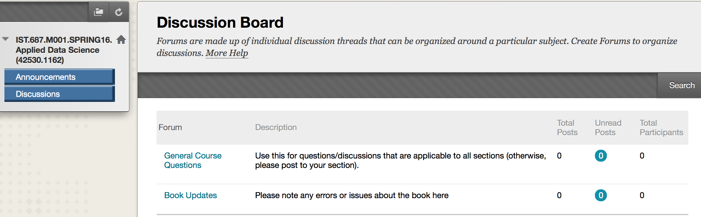
Blackboard

Slide 6
Blackboard

Slide 7
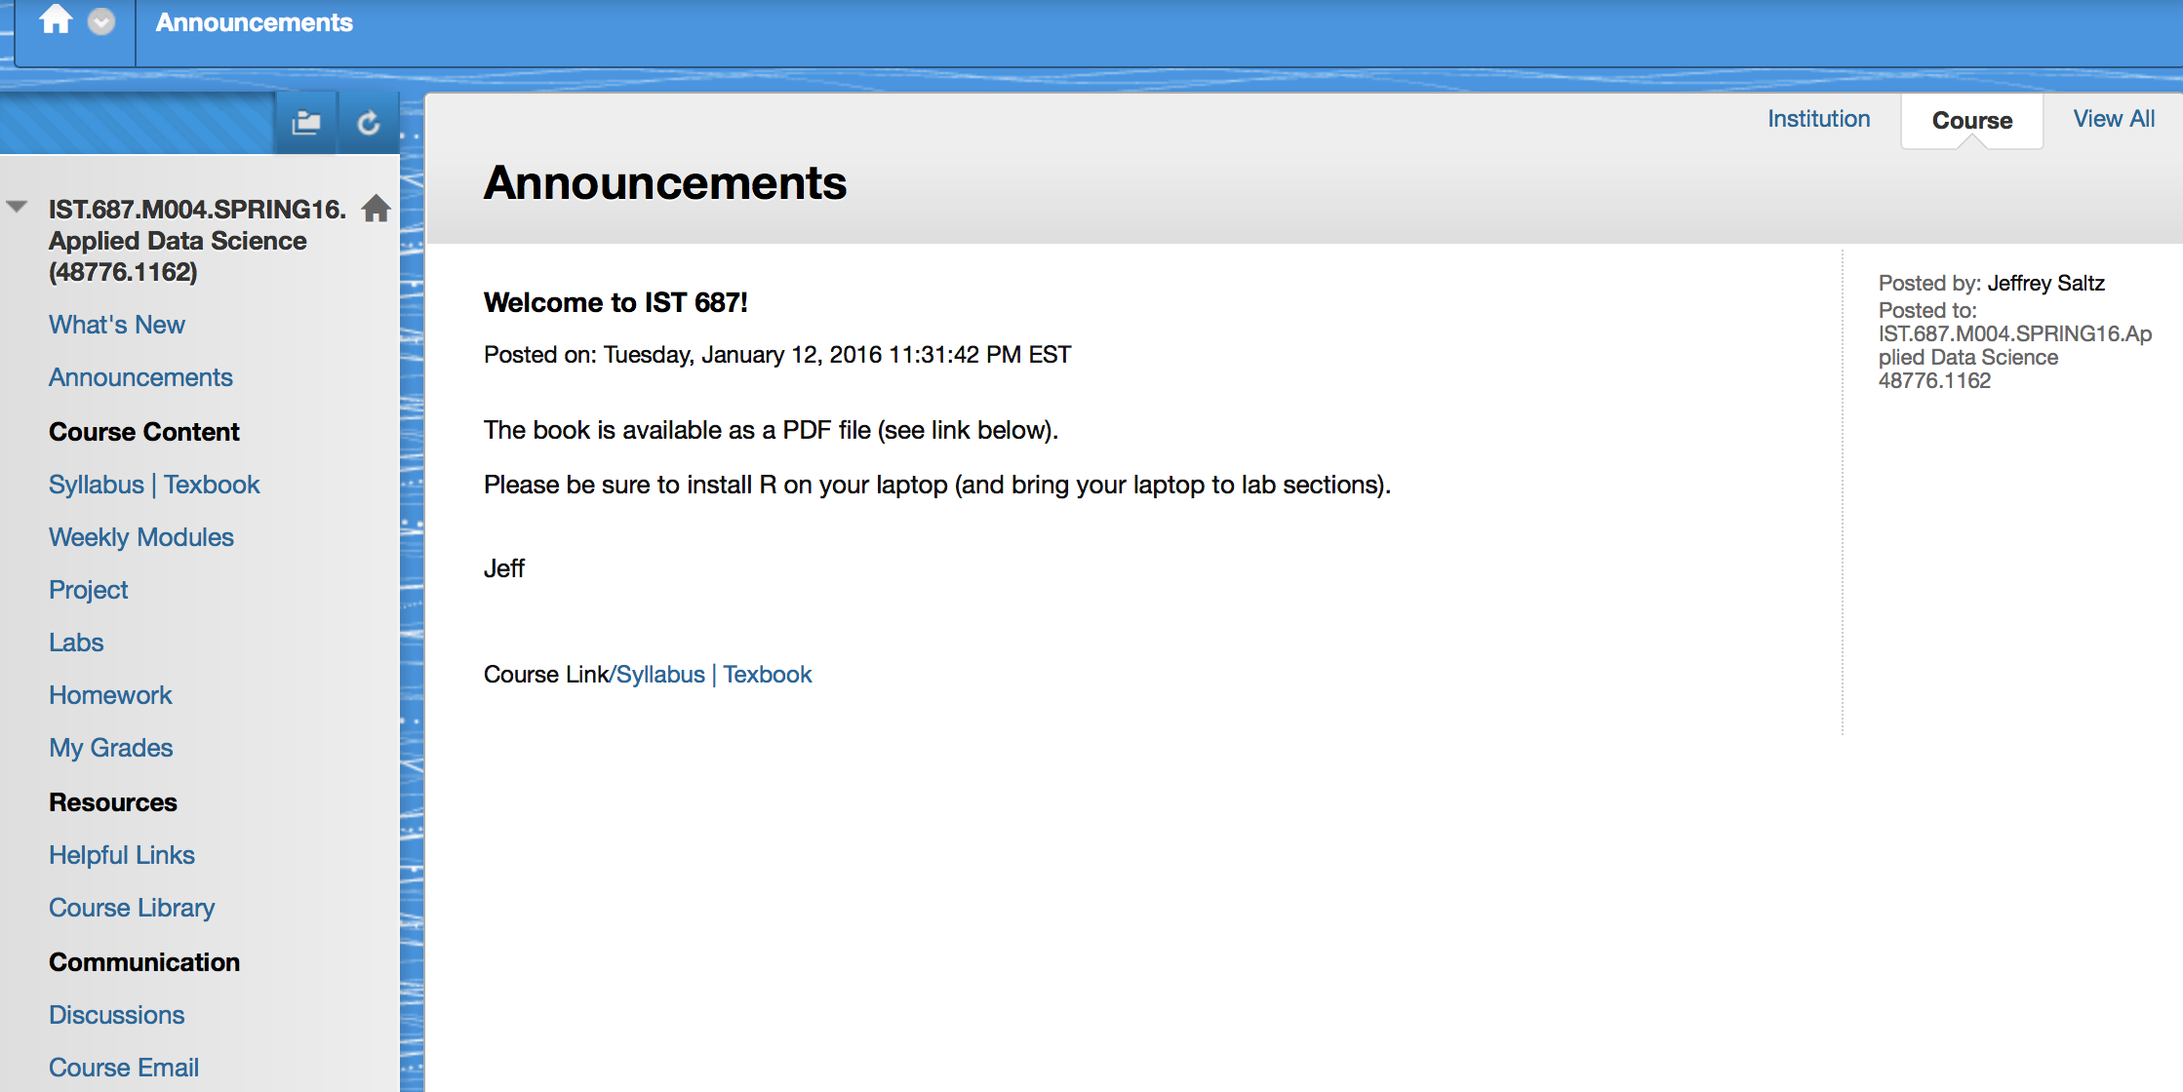
Blackboard

Slide 8
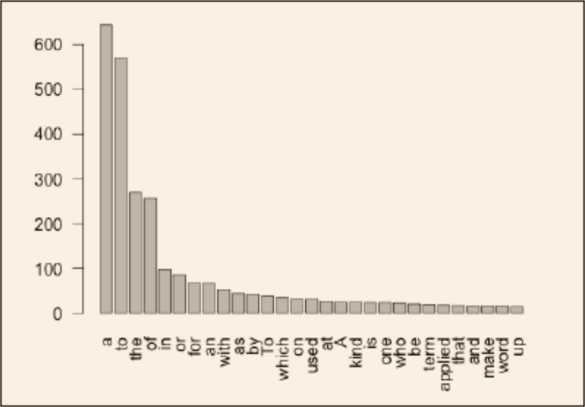
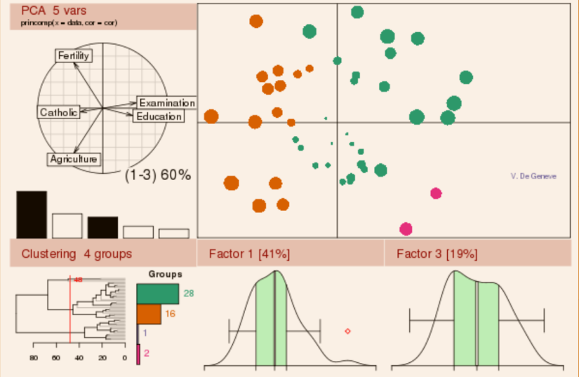
Data Science: Many Skills
Data science refers to an emerging area of work concerned with the collection, preparation, analysis, visualization, management, and preservation of large collections of information. Although the name Data Science seems to connect most strongly with areas such as databases and computer science, many different kinds of skills – including non-mathematical skills – are needed.

Slide 9
What is Data Science?
Data Science is different from other areas such as mathematics and statistics
→ Data scientists serve the needs and solve the problems of data users
→ Before you can solve a problem, you need to identify it
→ This process is not always as obvious as it might seem.

Slide 10
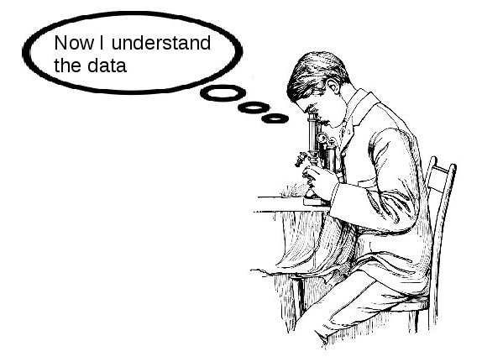
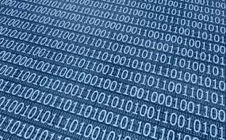
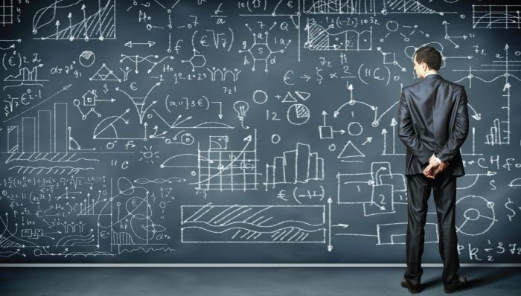

Data Science: Many Skills
Data Science→ Perception

Slide 11
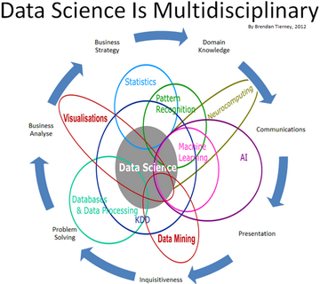
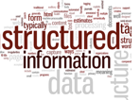
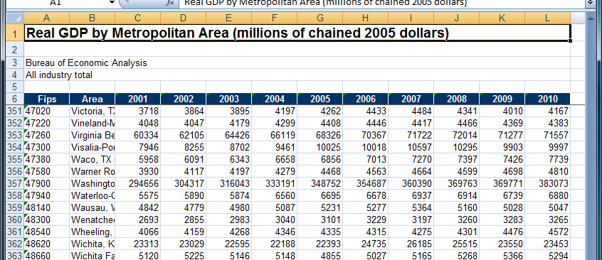
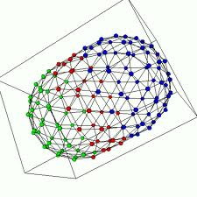

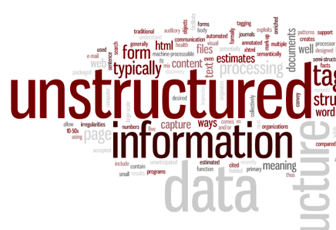
Data Science: Many Skills
Contemporary Perspective

Slide 12
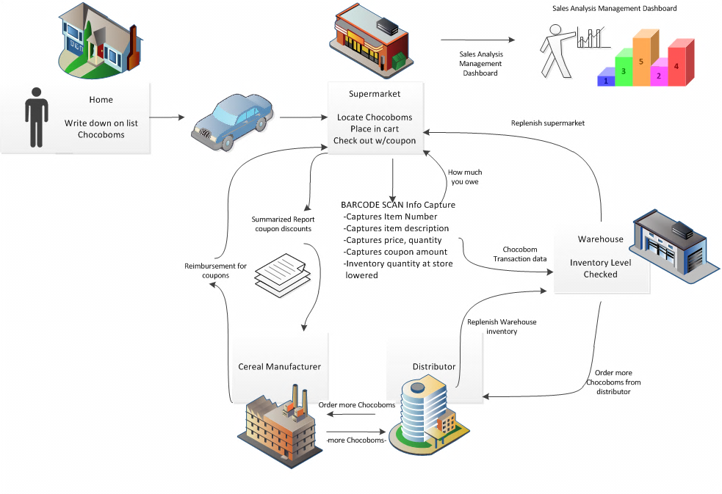

Slide 23
Data Architecture
Data Acquisition
Data Analysis
Data Archiving

Slide 24
Data Scientist: Many Skills
Learning the application domain
Communicating with data users
Seeing the “big picture”
Knowing how data can be represented
Data transformation & analysis
Visualization & presentation
Attention to quality

Slide 25
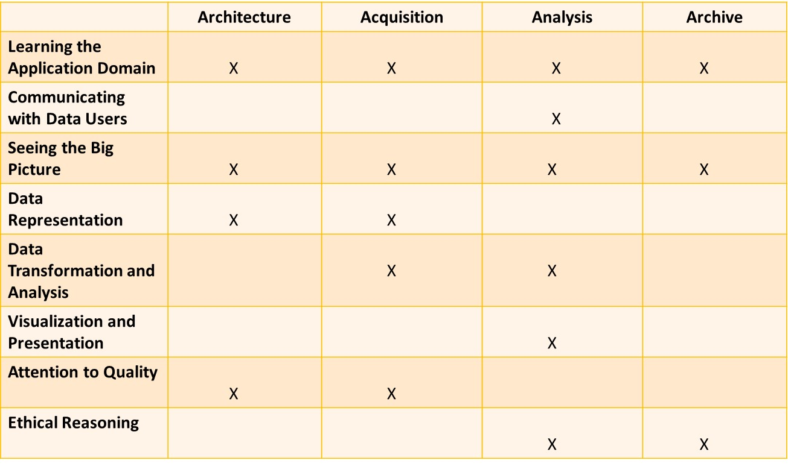
Data Science: Many Skills
Roles
Skills

Slide 26
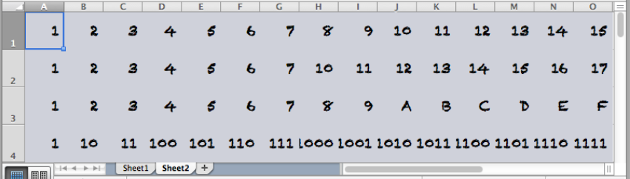
Data Science: About Data
Data comes from the Latin word, “datum”. Meaning a thing given. Although the term data has been used as early as the 1500s, modern usage started in the 1940s and 1950s as the age or era of computers started to emerge within a context of data input, process, data output.

Slide 27
Data Science
New business strategies, product bundling opportunities, measure success/failure of strategies
Wisdom
Customer Life time value assessment and associated marketing strategies: sustain, cultivate, convert
Intelligence
Sales Trend by Cust - Up, Down, New, Attrition
Product Line buying pattern
Value
Knowledge
Individual Customer Sales by Market Segment over “x” years
Information
Customer Sales
Data
SAP

Slide 28
Data Science: Identifying Data Problems
Data Science is different from other areas such as mathematics and statistics. Data Science is an applied activity and data scientists serve the needs and solve the problems of data users. Before you can solve a problem, you need to identify it and this process is not always as obvious as it might seem. In this segment we discuss the identification of data problems.

Slide 29
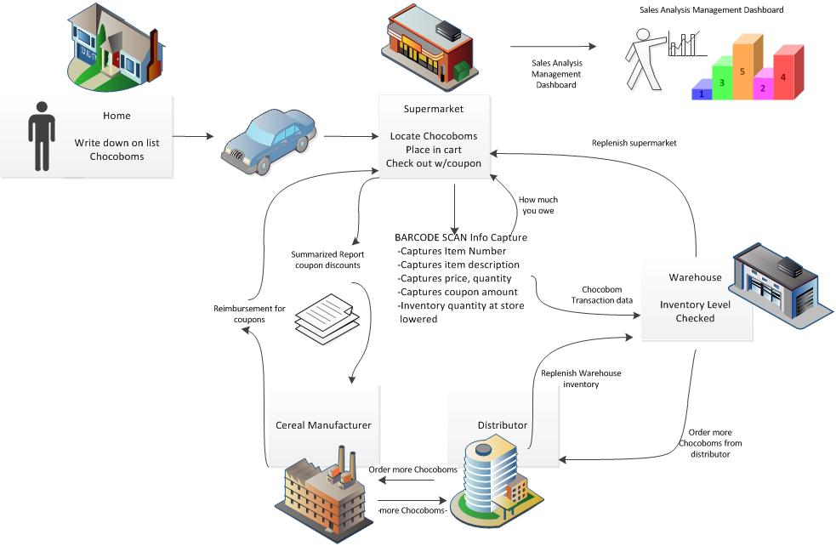
Data Science
Problem Domain
Scope
Boundaries
Focus Area
Context
Mitigate “boiling the ocean”

Slide 30
Data Science
Problem Domain
Scope
Boundaries
Focus Area
Context
Mitigate “boiling the ocean”

Slide 31
Data Science
Problem Domain
Scope
Boundaries
Focus Area
Context
Mitigate “boiling the ocean”

Slide 32
Data Science
Problem Domain
Scope
Boundaries
Focus Area
Context
Mitigate “boiling the ocean”

Slide 33
Data Science
Problem Domain
Scope
Boundaries
Focus Area
Context
Mitigate “boiling the ocean”

Slide 34
Data Science
Domain Analysis/De-composition
Identify Subject Matter Expert(s)
Question / Interview / Observation Process
Stories
Anomalies
Risks & Uncertainty

Slide 35
Data Science
Stories
What people do
How they do it
Information produced & consumed
Process & Information touch points
Decisions made
Challenges associated with all of the above

Slide 36
Data Science
Stories
What activity performed
How the activity is performed
Information produced & consumed
Process & Information touch points
Decisions made
Challenges associated with all of the above
As the “cashier” my job is to scan the bar code on each item to capture product and price information. I also scan coupons to capture item discount information which will reduce a customers total bill
As a cashier the challenges I encounter are item barcodes that are not legible, item barcodes that are invalid, and coupon rejections.

Slide 37
Data Science
Anomalies
Determine most typical events, activities, processes
Identify the exceptions

Slide 38
Data Science
Anomalies
Determine most typical events, activities, processes
Identify the exceptions
Item not found

Slide 39
Data Science
Summary
Domain identification is essential such that we zero in on the right problem or opportunity
Identify SME’s and engage them in “story telling” about their activities such that you can get a sense of who, what, why, they do what they do to also include surfacing anomalies and risk situations

Slide 40
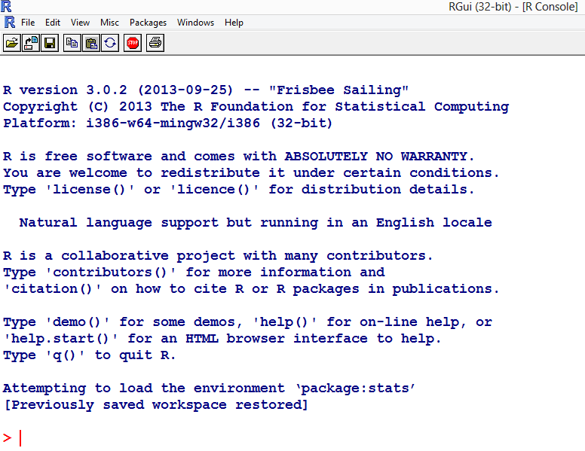
Data Science: Getting Started with R
R” is an open source software program, developed by volunteers as a service to the community of scientists, researchers, and data analysts who use it. R is free to download and use. Lots of advice is available online to help users learn R, which is good because it is a powerful and complex program, in reality a full featured programming language dedicated to data.

Slide 41
Data Science
“R” early take-away’s
Command line oriented
Not especially good at giving feedback or error messages
Know your data

Slide 42
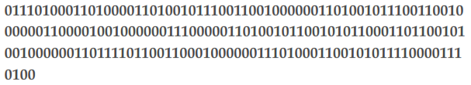
Data Science
Character String
“this is a piece of text”
“R” code myText <- “this is a piece of text”

Slide 43
Data Science
List of integers 43, 42, 12, 8, 5
Each integer represents the age of a family member
Integer list is all the same “type/mode”
“R” refers to a list where all the items are of the same type as a “vector”
“R” code for this vector looks like
c (43, 42, 12, 8, 5)
myFamilyAges <- c (43, 42, 12, 8, 5)
Dataset

Slide 44
Data Science
“R” Hands-on
Start up “R”
Clear “R” console start up text … control l (lower case L)
Create/key in at the command prompt >
MyText<-”this is a piece of text”
Retrieve MyText
Retrieve mytext
Create/key in at the command prompt >
myFamilyAges <-c(43, 42, 12, 8, 5)
Retrieve myFamilyAges
End “R” …. q() at the command prompt >
Respond ‘yes’ to save your work space

Slide 45
Data Science

Slide 46
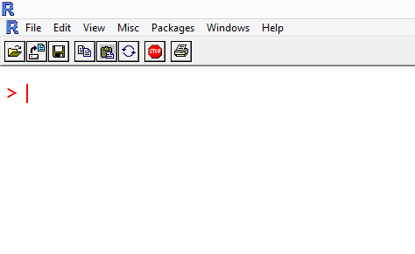
Data Science
Edit → Clear Console or Control L

Slide 47
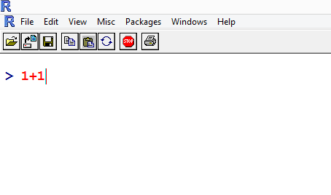
Data Science

Slide 48
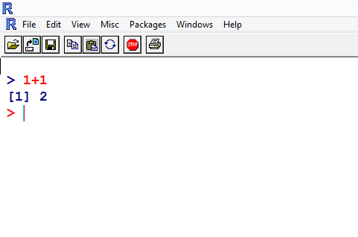
Data Science

Slide 49
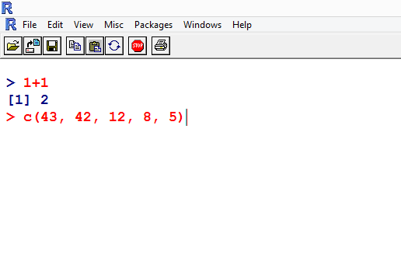
Data Science

Slide 50
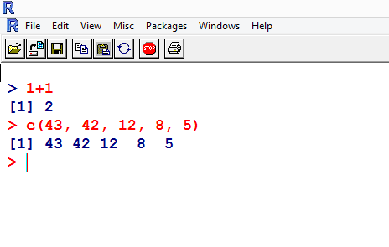
Data Science

Slide 51
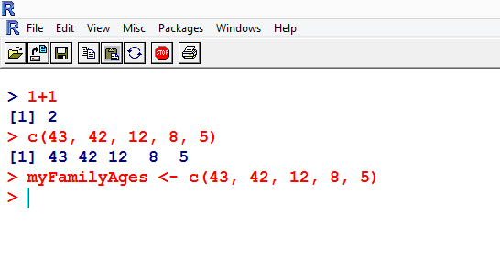
Data Science

Slide 52
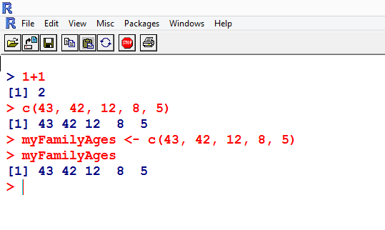
Data Science

Slide 53
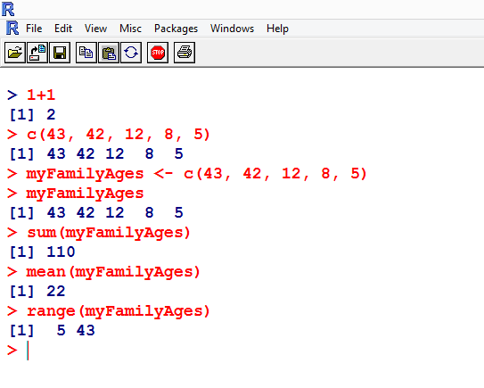
Data Science
sum
mean
range

Slide 54
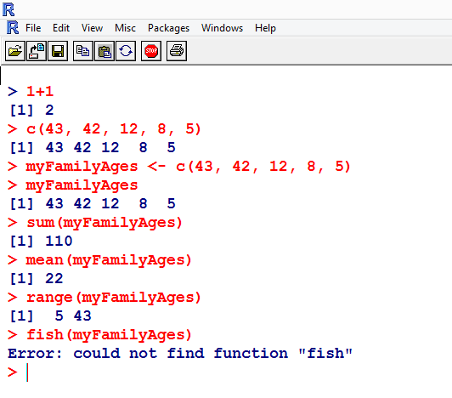
Data Science

Slide 55
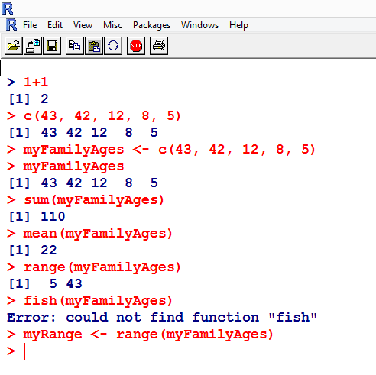
Data Science

Slide 56
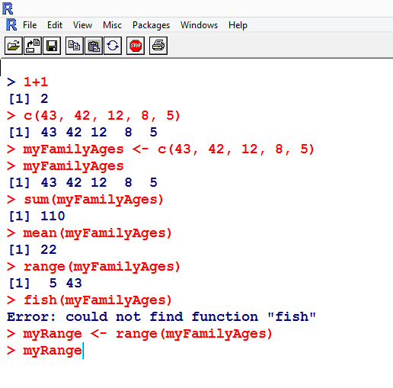
Data Science

Slide 57
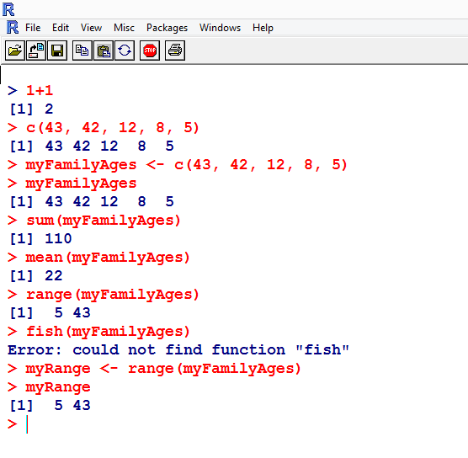
Data Science

Slide 58
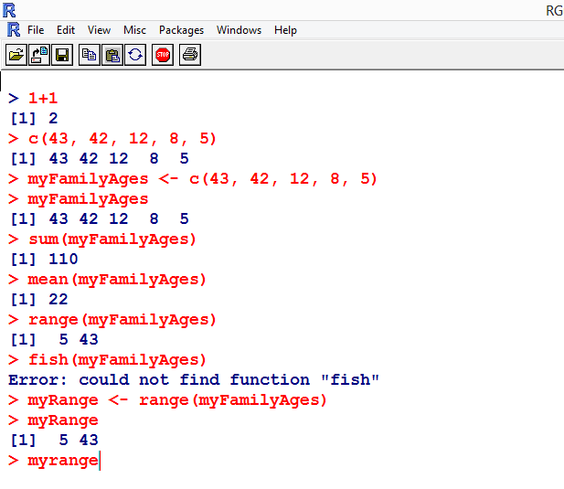
Data Science

Slide 59
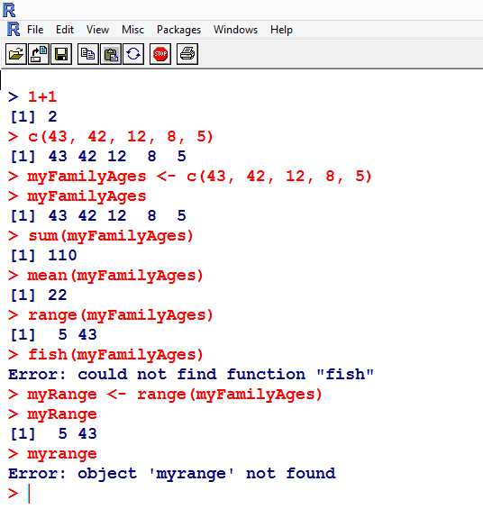
Data Science

Slide 60
Data Science
“R” late take-away’s
The use of the “c()” function
The vector is a basic form of data storage
A vector can be stored in a named location using the arrow “<-”
You can get the data object a named location by typing the name
Capitalization matters
You can run a function ie. sum, mean, range
Legal functions include sum, mean, range and fish is not a legal function

Slide 61
Data Science
Summary
“R” open source data analysis tool
Numbers and text can be collected in lists -> Vector
Vector has a length (number of items in it)
Vector has a mode (type of data stored in the vector)
myFamilyAges vector has a length and a mode of integer
Vector can be labeled i.e. myFamilyAges
Named list (myFamilyAges) is also referred to as a variable and/or a dataset
Typically more than 1 variable or dataset is used for analysis

Slide 62
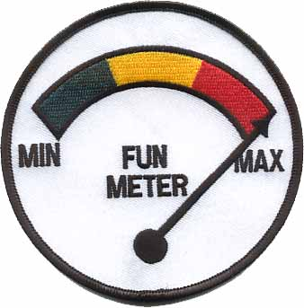
Data Science
Data Science Fun Meter

